Slide 1
Welcome Everyone!
Class Topics:
What is Flutter?
Why do companies choose Flutter?
What is Computer
History of Computer
How a computer works
What is RAM?
What is ROM?
এগুলা জেনে কী হবে?

Slide 2
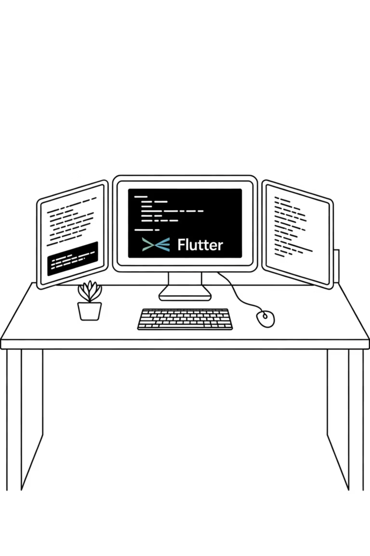
Why Start With Computers?
Before diving into Flutter development, we need to understand the foundation - how computers actually work. This knowledge will make you a better developer and help you avoid common pitfalls.

Slide 3

Imagine trying to build a skyscraper without knowing what bricks are. 💡
Same with Flutter – before coding apps, you must know how computers think.
Flutter runs on computers, mobiles, devices – let's peek inside their brains first.
Story: "When I first learned Flutter, I ignored basics. Later, one bug took me 3 days to fix because I didn't understand memory properly. Don't repeat my mistake!"

Slide 4
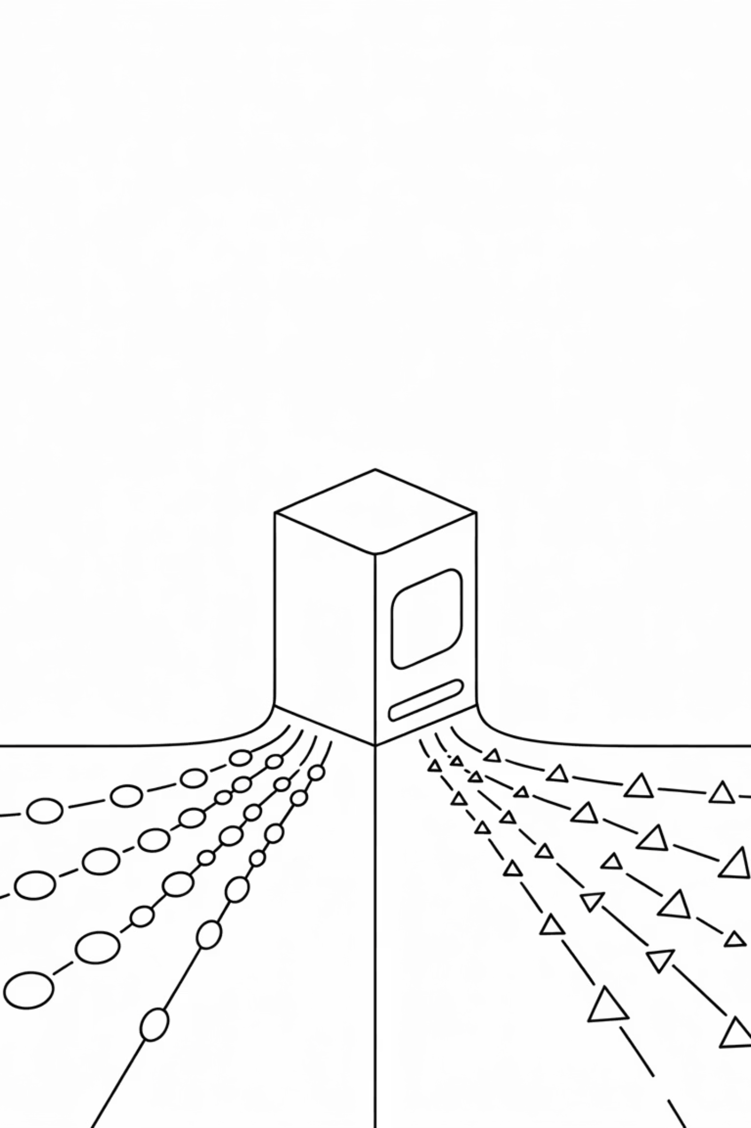





What is a Computer? (Simple Definition)
Accepts input
Processes
Produces output
Stores it
A computer = A smart servant (takes orders, gives results).
Not "magic", just fast calculations + storage.
Interactive: Ask students: "If your brain is a computer, what's your RAM? What's your ROM?"

Slide 5

A Quick History of Computers
1st Generation: Big, heavy, vacuum tubes.
1
2
2nd Gen: Transistors made computers smaller.
3rd Gen: Integrated circuits (ICs) – faster, cheaper.
3
4
4th Gen: Microprocessors – personal computers.
5th Gen: Today – AI, smartphones, Flutter apps!
5
Story: "My dad had a PC with floppy disks. That thing took 5 minutes to start. Now, I open Flutter and my emulator runs in seconds. That's progress!"

Slide 6
Why History Matters for Flutter Devs?
Shows how hardware limitations shaped software.
Explains why we care about performance in apps.
Flutter apps run on small devices → optimization is key.
Example: Old computers had 64KB memory. Today's phones have 8GB RAM. That's why Flutter apps can look smooth like native apps.

Slide 7








How a Computer Works (The Cycle)
Input: Keyboard, touch, voice.
Process: CPU (the brain).
Output: Screen, speakers.
Memory: RAM/ROM.
Interactive: Draw the cycle on board. Ask students: "When you tap a button in Flutter, which part of the cycle is triggered?"

Slide 8
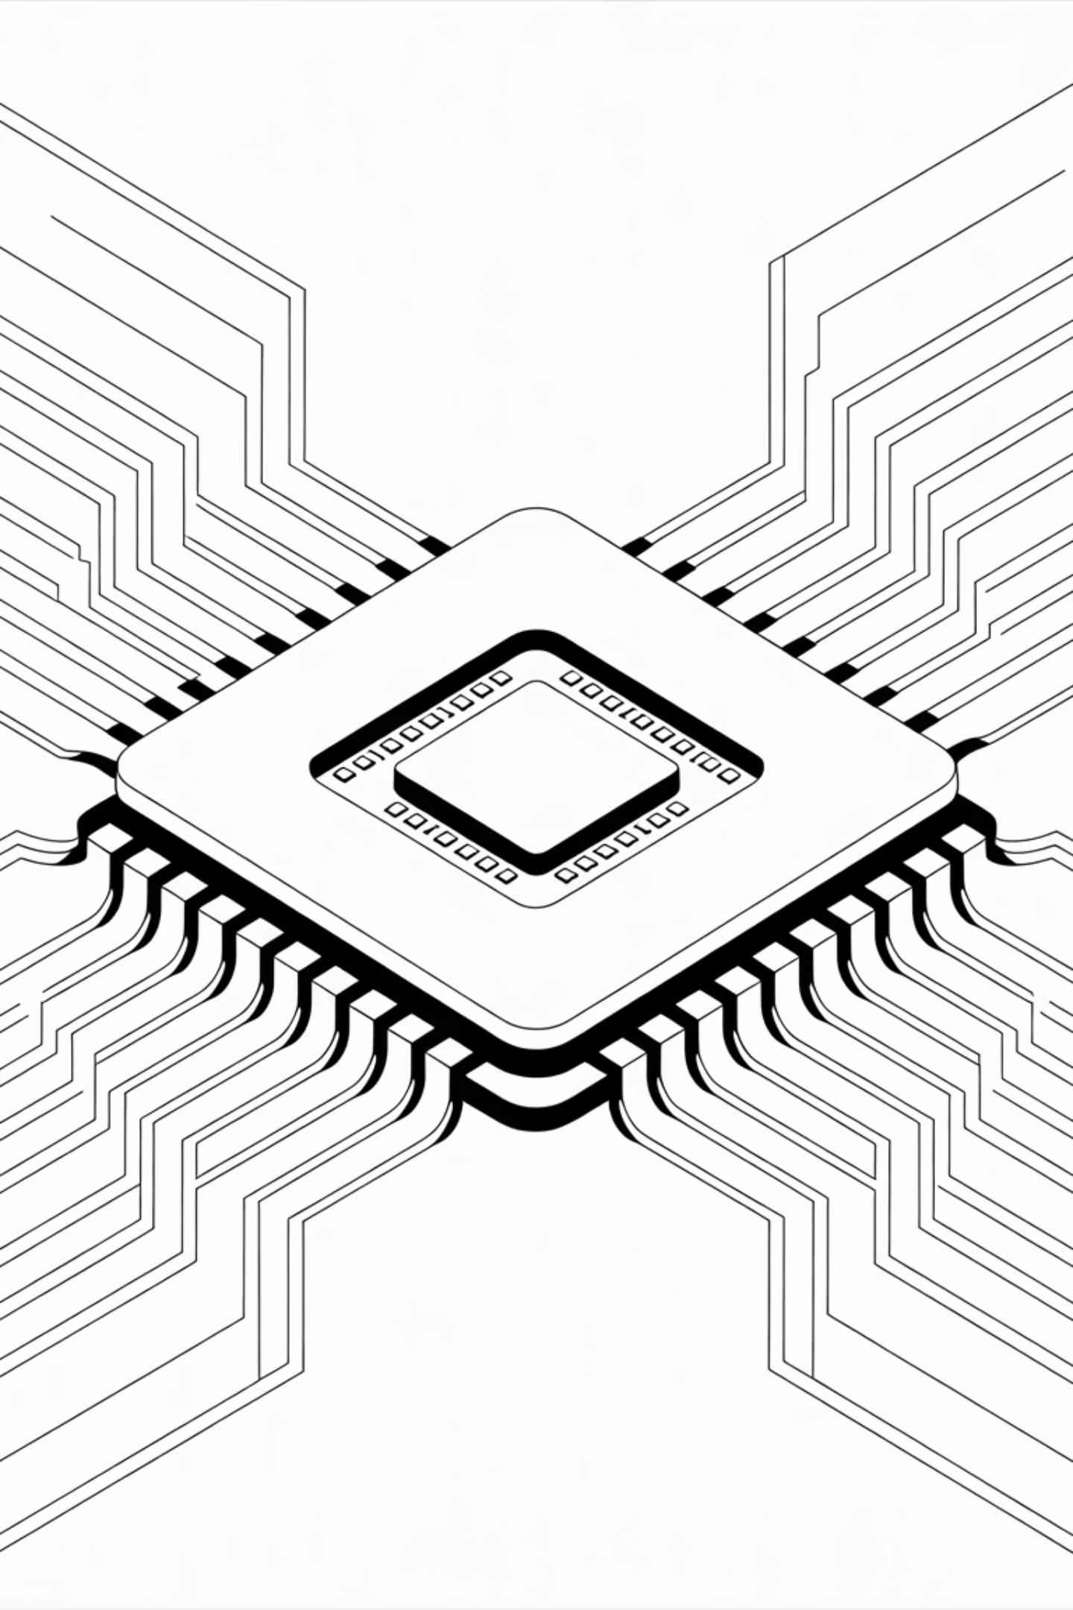
CPU – The Brain of Computer
Executes instructions line by line.
Works with RAM closely.
Speed measured in GHz (billions of steps per second).
Story: "One of my first apps ran super slow. I blamed Flutter. Later I realized, my old laptop's CPU was just too weak. Hardware matters!"

Slide 9
RAM – The Short-Term Memory
Temporary memory, clears after shutdown.
Stores data while app is running.
More RAM = more smooth multitasking.
Flutter Relevance: When you open Android Emulator + VS Code + Flutter project → RAM usage spikes. That's why low-RAM PCs lag badly.

Slide 10
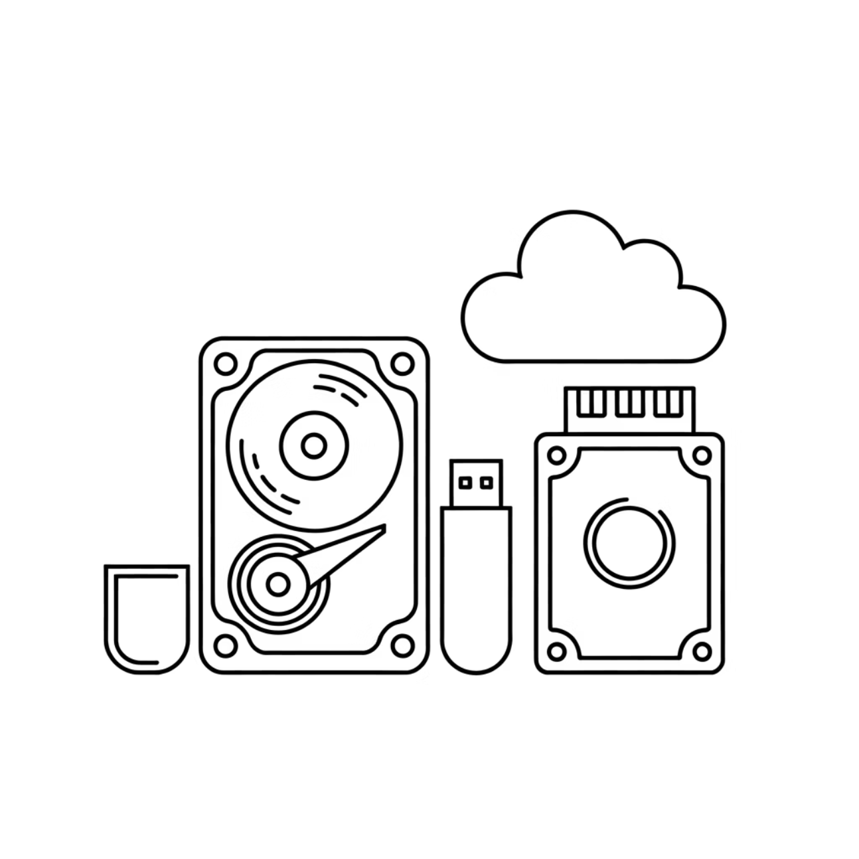
ROM – The Long-Term Memory
Permanent storage (doesn't vanish after restart).
Stores OS, system files.
Without ROM → no booting.
Flutter Relevance: When you install Flutter SDK, Android Studio, Emulator → All stored in ROM (your hard drive).

Slide 11




Why RAM & ROM Matter in Flutter
Flutter apps use RAM during hot reloads.
Flutter SDK + Emulator live in ROM.
Knowing this saves you from silly issues.
Example: Students often say "My emulator is not running!" → 90% of time, low RAM or storage issue.
Wrap-Up & Takeaway
Computer = smart servant (input → process → output).
History shows why performance matters.
CPU, RAM, ROM = the real stage where Flutter performs.
Learn basics → Build apps without fear.
Interactive Ending: Ask: "Next time your emulator crashes, what will you check first: RAM or ROM?"

